Slide 1



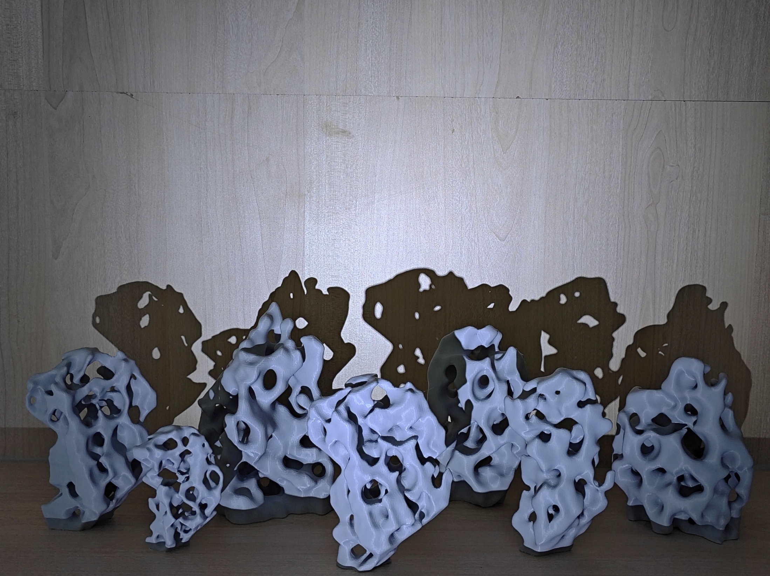



Visual Permeability-Driven Generation of Support-Free Stochastic Porous Structures
Xiaokang Liu¹, Kaifeng Tian², Lingxin Cao², Longdu Liu², Lihao Tian², Bingteng Sun³, Changhe Tu², Lin Lu², Baoquan Chen¹
¹Peking University |
²Shandong University |
³Chinese Academy of Sciences
SPM 2026 - Istanbul Technical University, Türkiye
Notes:
Thank you, and good morning everyone.
My name is Xiaokang Liu from Peking University.
I‘m very happy to present our work: Visual Permeability-Driven Generation of Support-Free Stochastic Porous Structures.

Slide 2
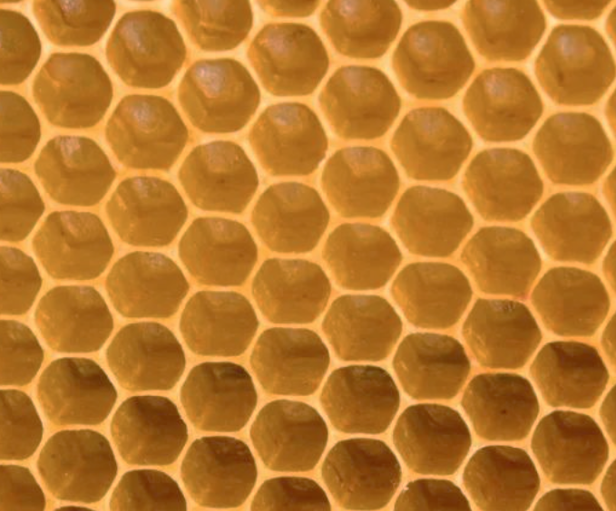
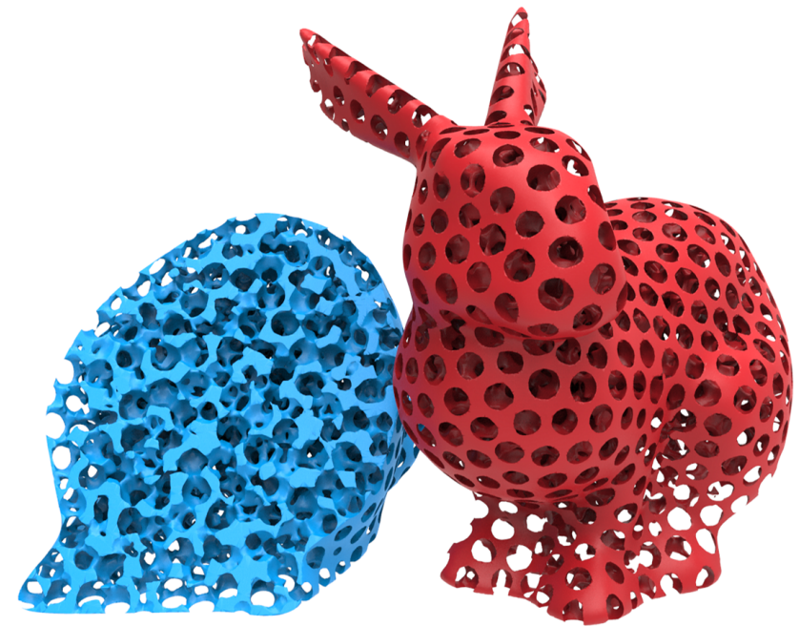
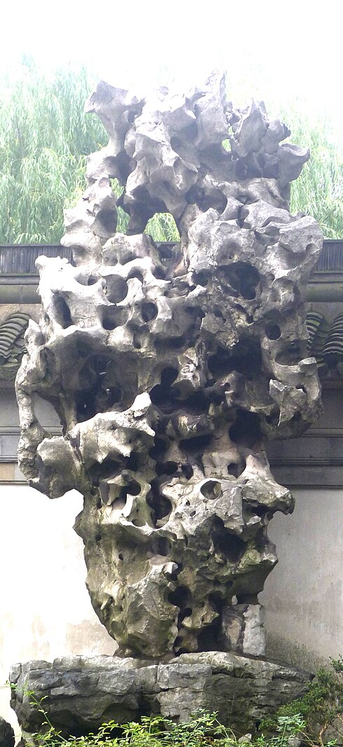
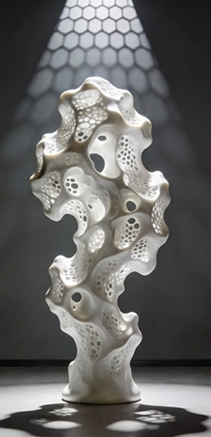
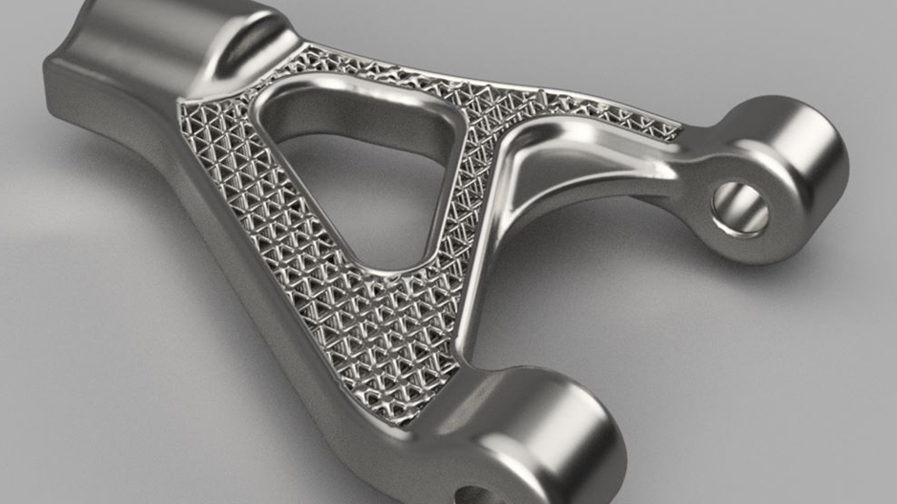
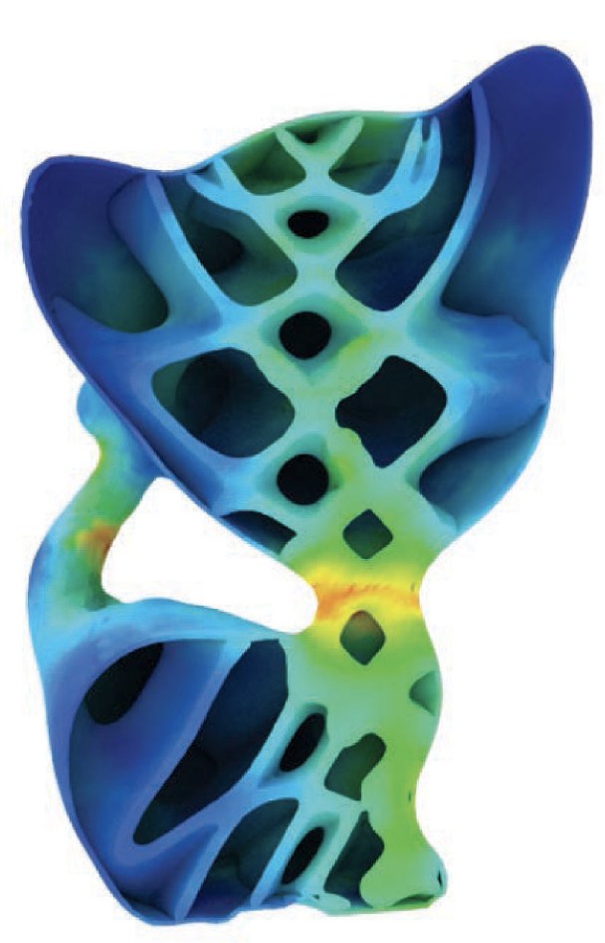
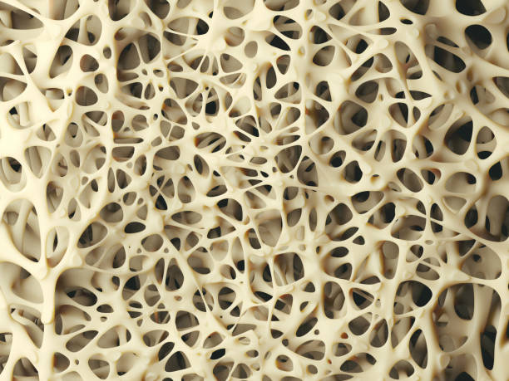
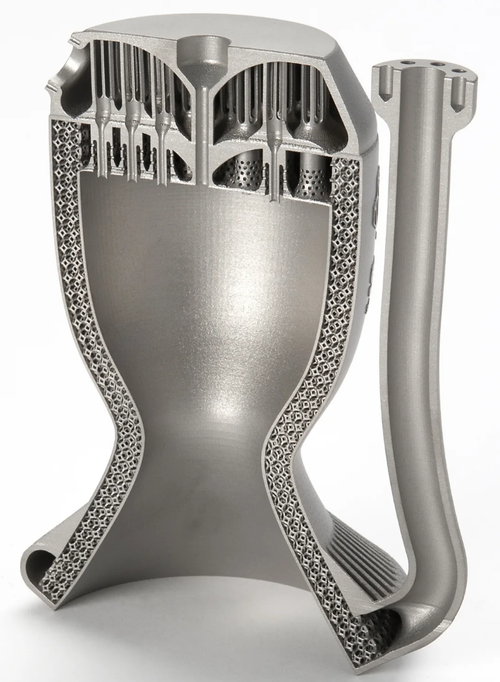
Porous Structures: Beyond Physical Performance
Honeycomb, Bone & Engineering materials
Landscape & Architectural art
Visual Permeability
Notes:
Porous structures are everywhere.
They are widely found in nature and engineering materials, because of their properties like lightweight construction, mass transport, and energy absorption and buffering.
But in landscape design and architectural art, there is another quality that matters deeply — and that is visual permeability.

Slide 3
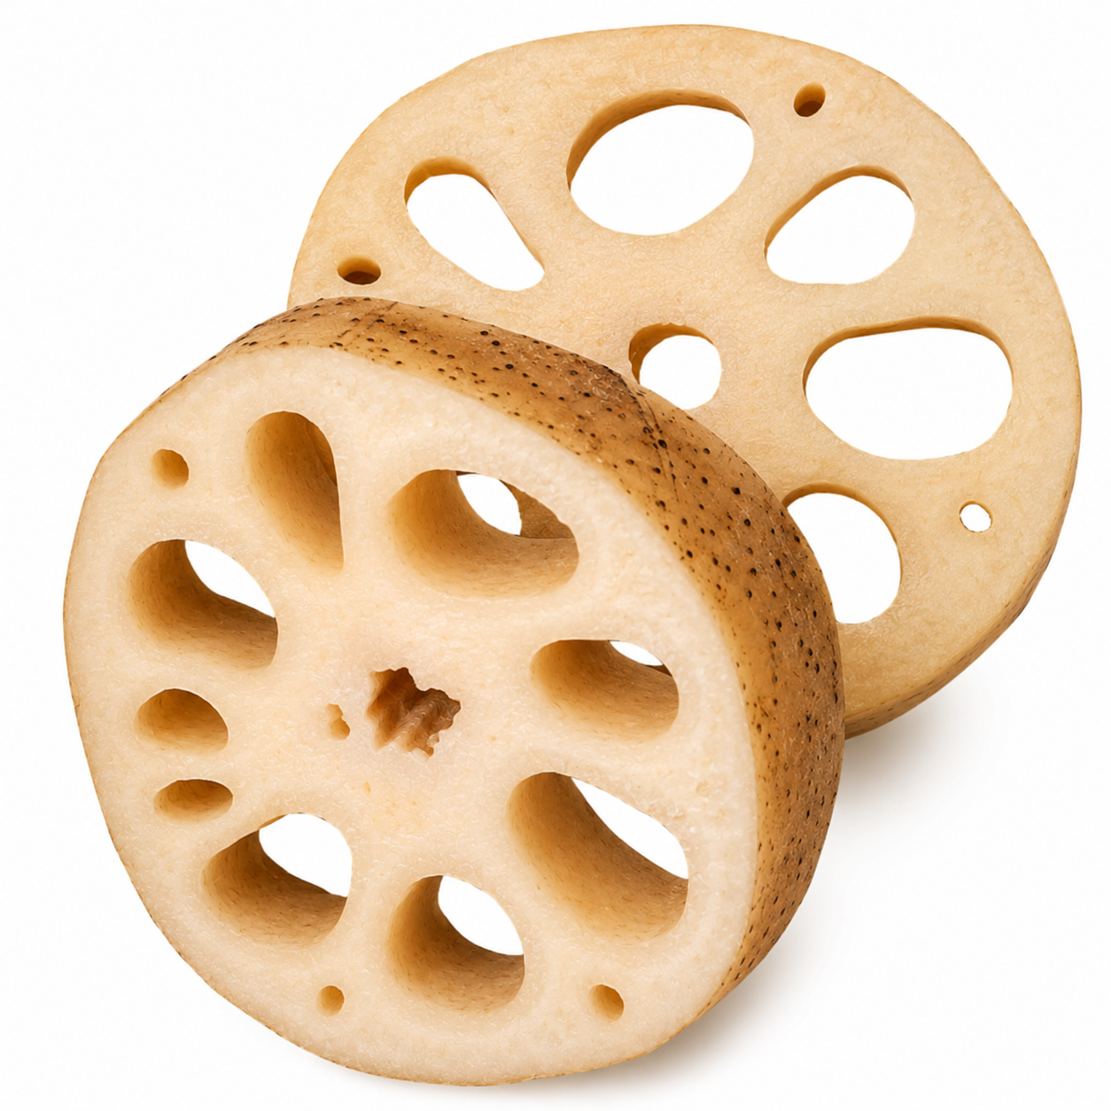
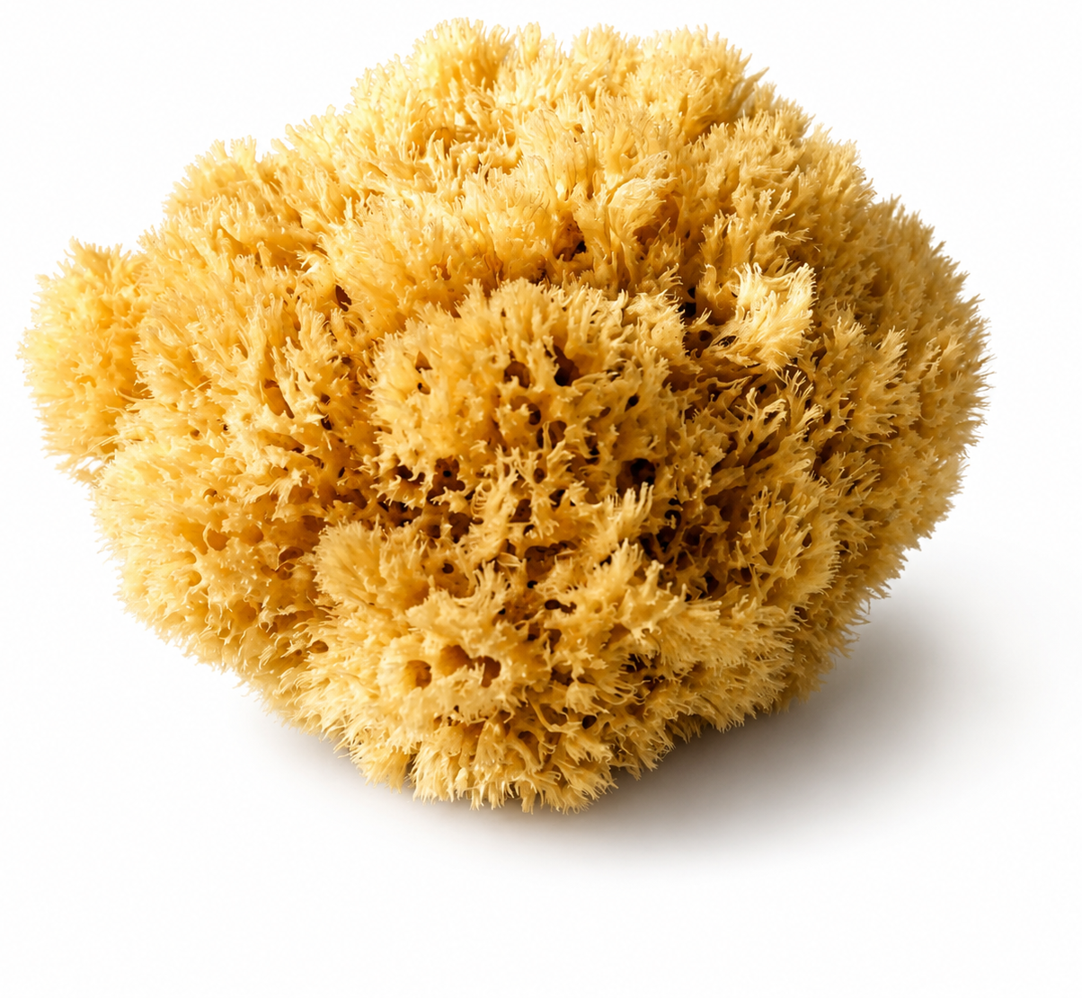
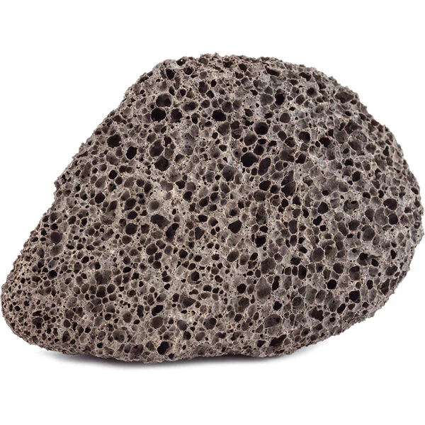
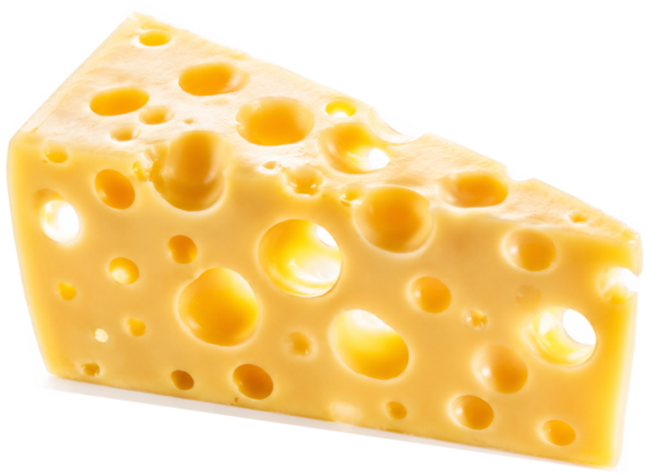
Visual Permeability (VP)
Visual Permeability (VP) captures perceptual openness
It is one where internal voids organize into coherent sightlines, allowing the viewer to see through the structure.
Instead of asking:
How many voids do we have?
vs
we ask:
Do these voids form meaningful sightlines?
Lotus root & Cheese
Porosity: 25%~45%
Sponge & Pumice Stone
Porosity: 70%~90%
High Visual Permeability ≠ High Porosity

Slide 4
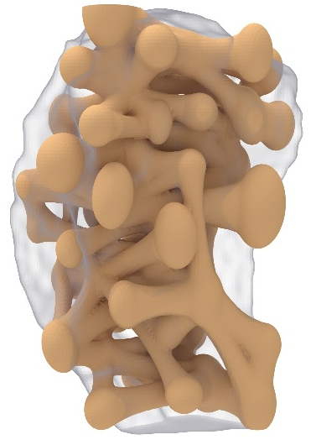


Core Insight
VP is governed by Geometric Visibility Capacity & Topological Pathway Organization
Geometric visibility capacity:
Pore scale
Tunnel radius
Cross-sectional area
Local pore thickness
Topological Pathway Organization:
Path straightness
Penetration depth
Spatial traversal preference
Viewing orientation
Coupled geometric variables;
Combinatorial Explosion.
Coherent pathways are the prerequisite for VP.
By abstracting pores and tunnels as a graph, we turn pathway organization optimization into graph connectivity optimization.
Notes:
Geometry affects how much light can pass, but pathway organization determines whether a coherent sightline exists.

Slide 5
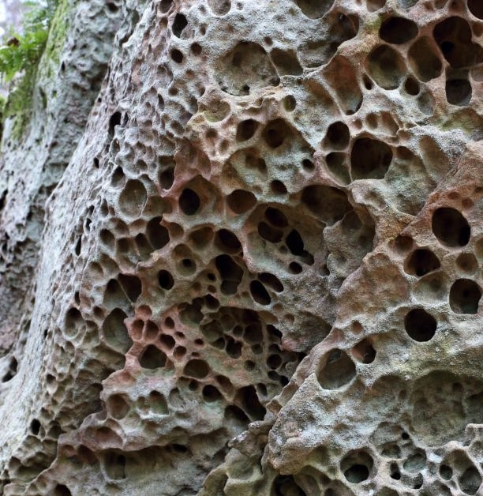
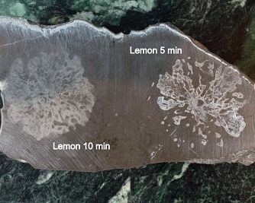
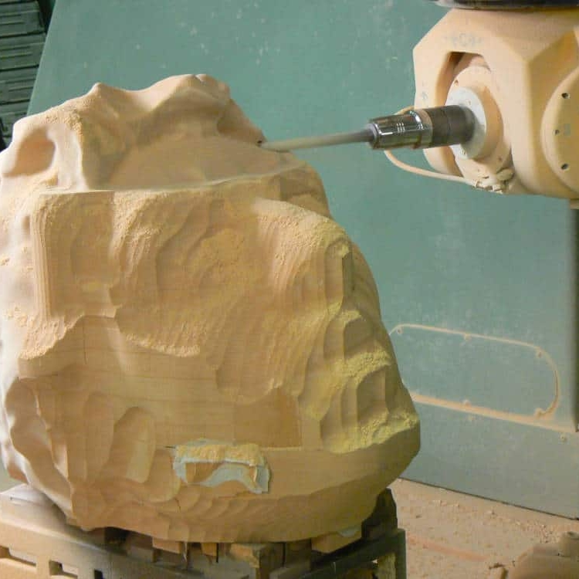
Why Support-Free Matters?
Why Additive Manufacturing?
Natural weathering
rare, uncontrollable
Chemical etching
limited control
Subtractive manufacturing
simple internal channels
Additive manufacturing
complex internal channels
Why Support-Free?
Support-Free is REQUIRED
Printing internal supports wastes massive material and time.
Internal supports in complex porous structures are difficult to remove.
Mechanical removal inevitably damages the aesthetic surface.

Slide 6
The Design Trilemma
Our Goal: A unified generative framework that resolves this trilemma.
Stochastic / Organic Morphology
Explicit Controllability
over VP
Support-Free Manufacturability
Notes:
Therefore, our goal is to propose a unified generative framework that simultaneously achieves organic stochasticity, explicitly controllable VP, and intrinsically support-free manufacturability.

Slide 7
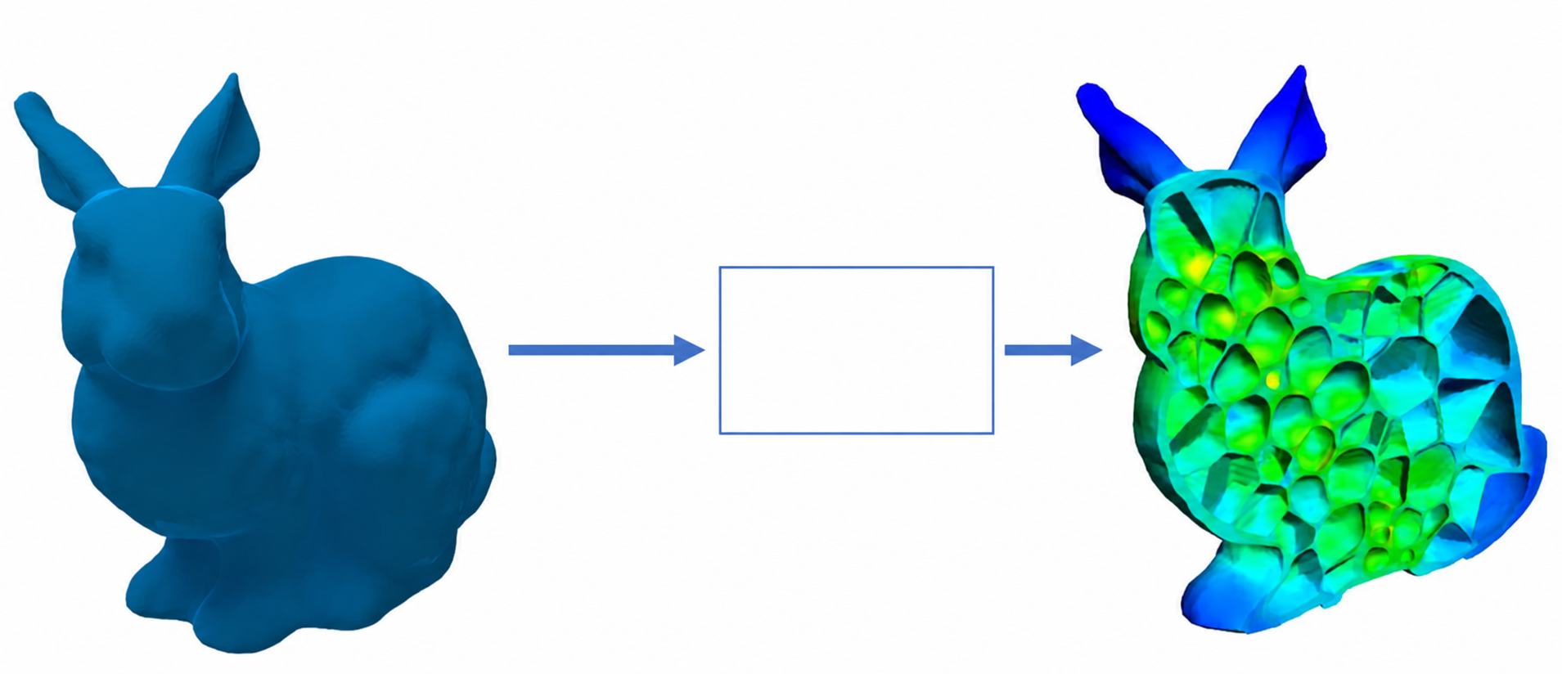
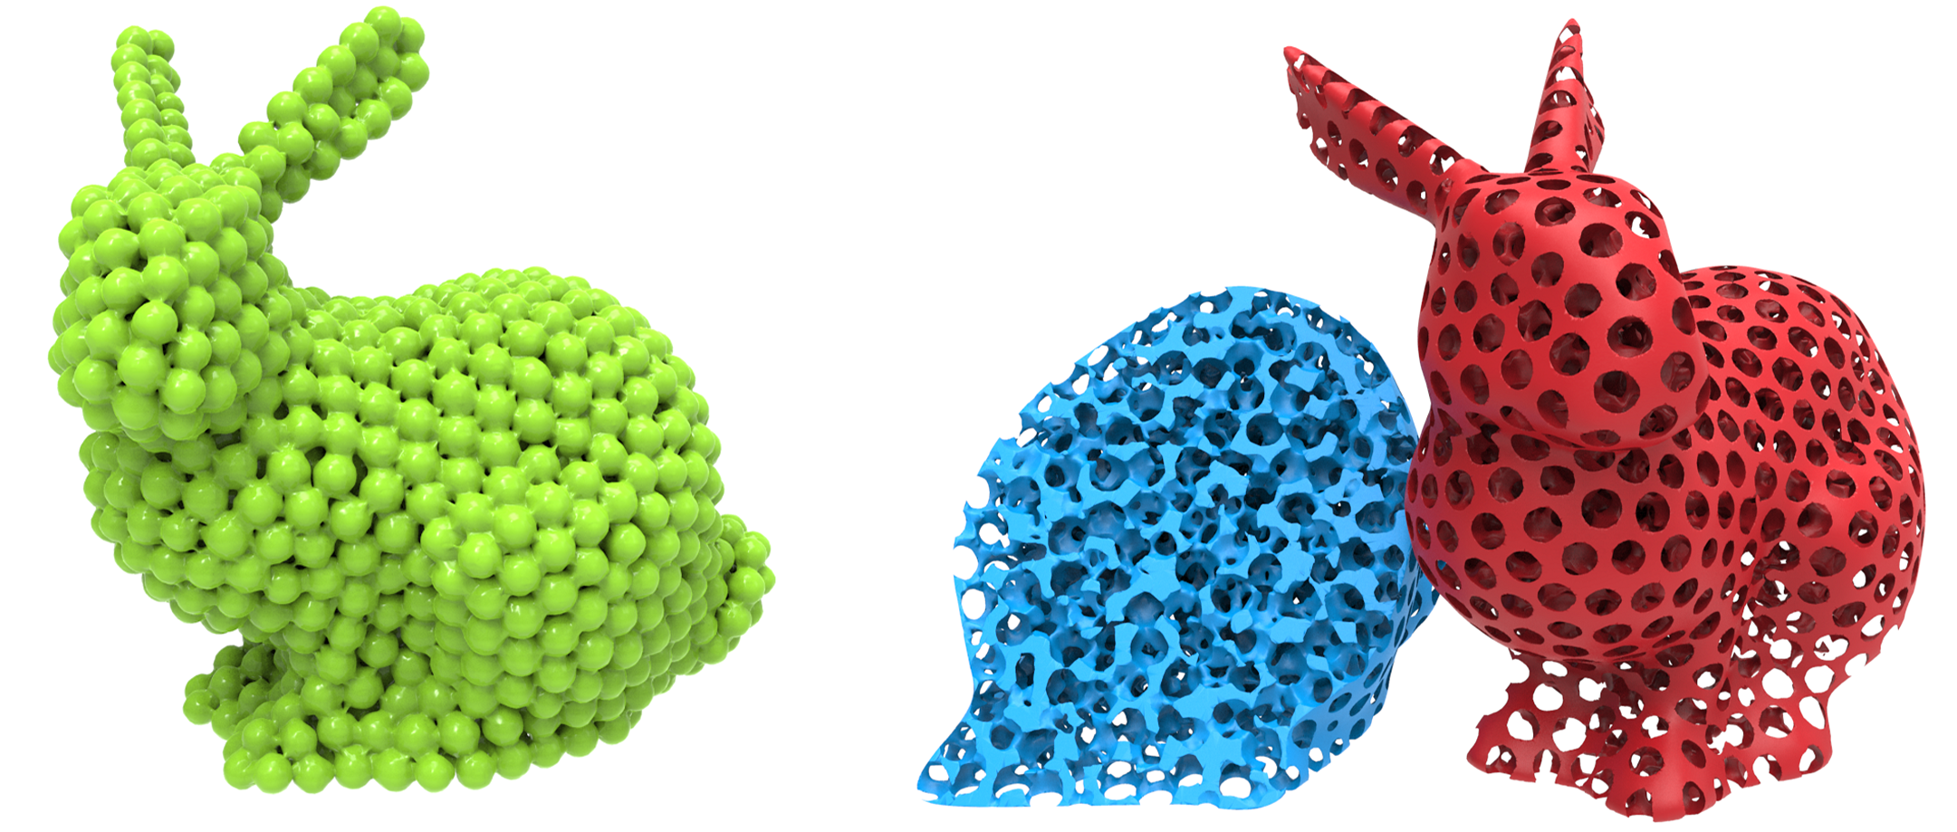
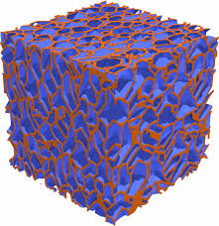
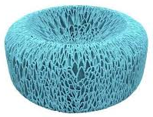
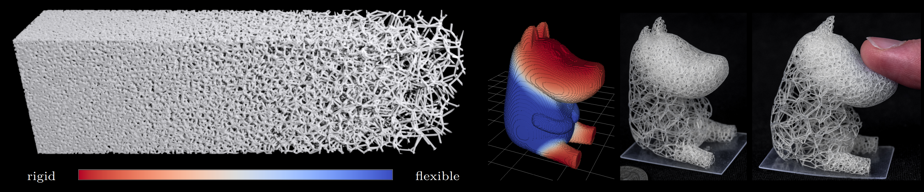
Related Work
Stochastic / Organic Morphology
Explicit Controllability
over VP
Support-Free Manufacturability
Design Space:
Entire Model
Geometric Constraints
Modeling and Optimization Process
Physical Objectives
Lu L. et al. TOG, 2014
Tian L, et al. ACM SCF. 2020
Martínez J. et al. TOG, 2016
Martínez J, et al. TOG. 2018
High computational complexity limits scalability; indirect parameter control hinders precise design.

Slide 8
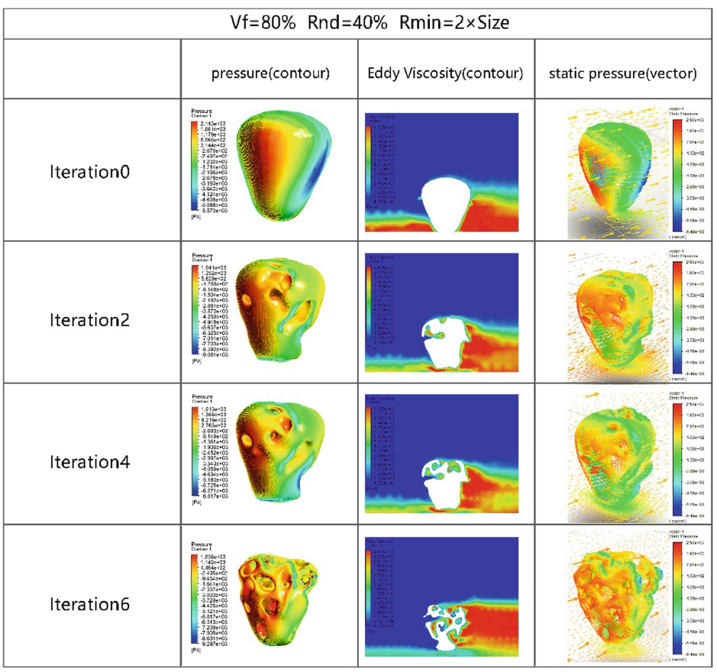
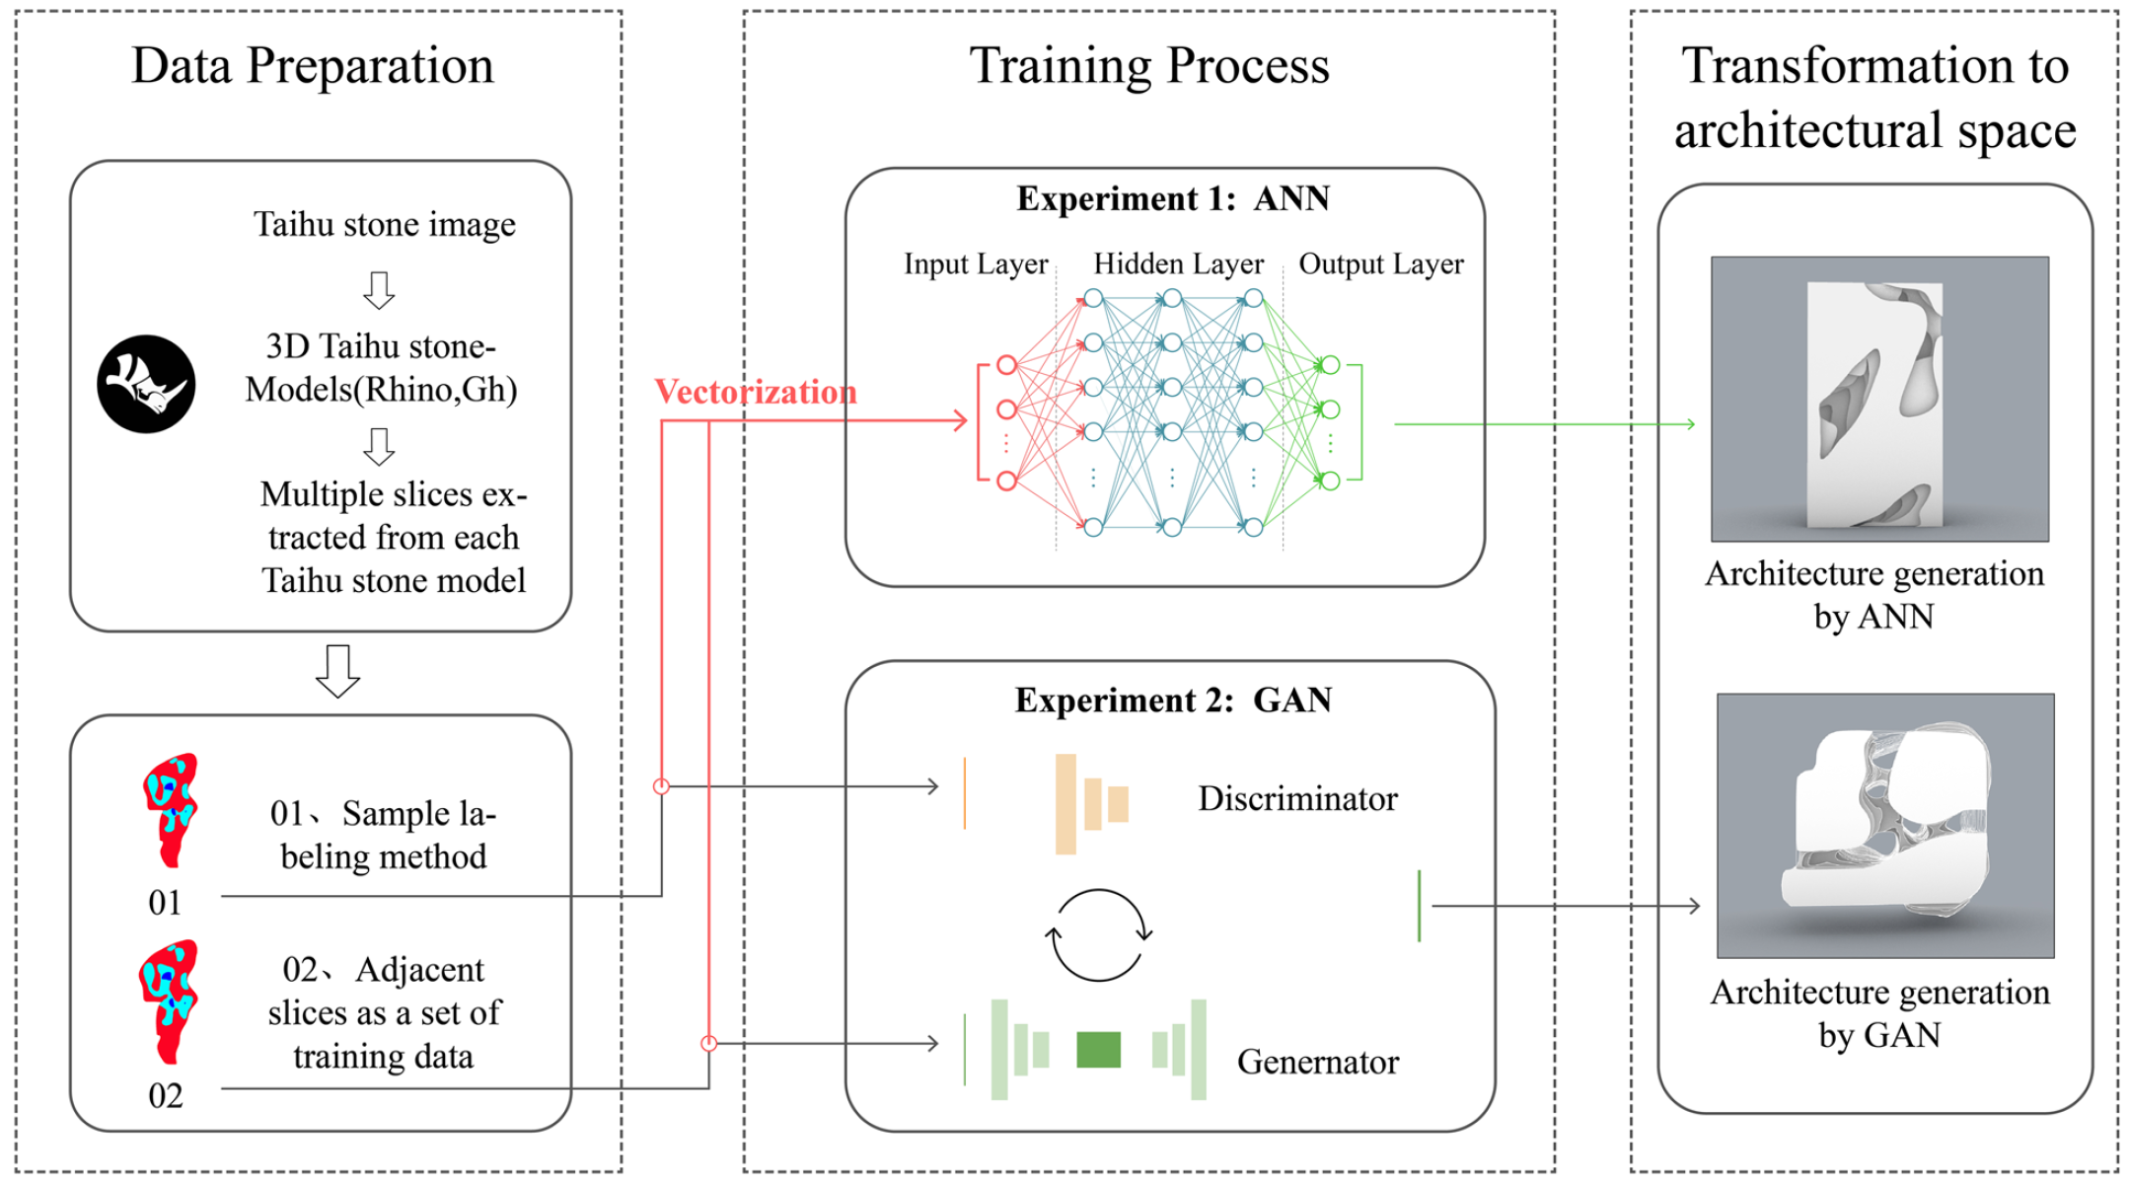
Related Work
Stochastic / Organic Morphology
Explicit Controllability
over VP
Support-Free Manufacturability
Feng Z, et al. The international conference on computational design and robotic fabrication. 2021
Deng Q, et al. Architectural Intelligence, 2023
Lack of support-free guarantee and quantitative metrics for explicit internal structure control.

Slide 9
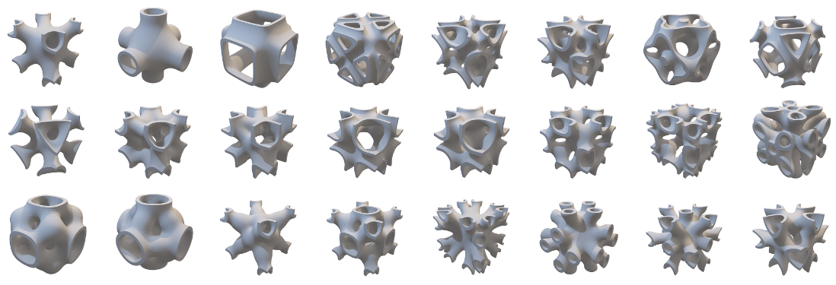
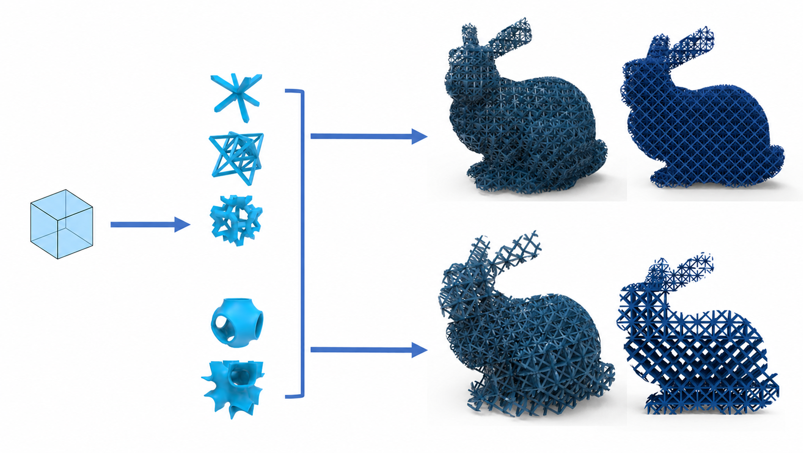
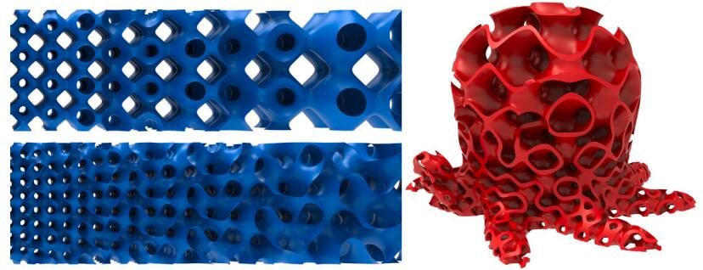
Related Work
All three are practical necessities — not optional optimizations. No existing method satisfies all three simultaneously:
Stochastic / Organic Morphology
Explicit Controllability
Support-Free Manufacturability
Design Space:
Periodic Unit Cell
Tessellation
Design
Liu P, et al. Additive Manufacturing, 2022
Composition
Generated Microstructures
Cross-Section
Tian, et al. Additive Manufacturing, 2024
Exhibit periodic or quasi-periodic repetition, lacking the inherent irregularity and organic variation.

Slide 10
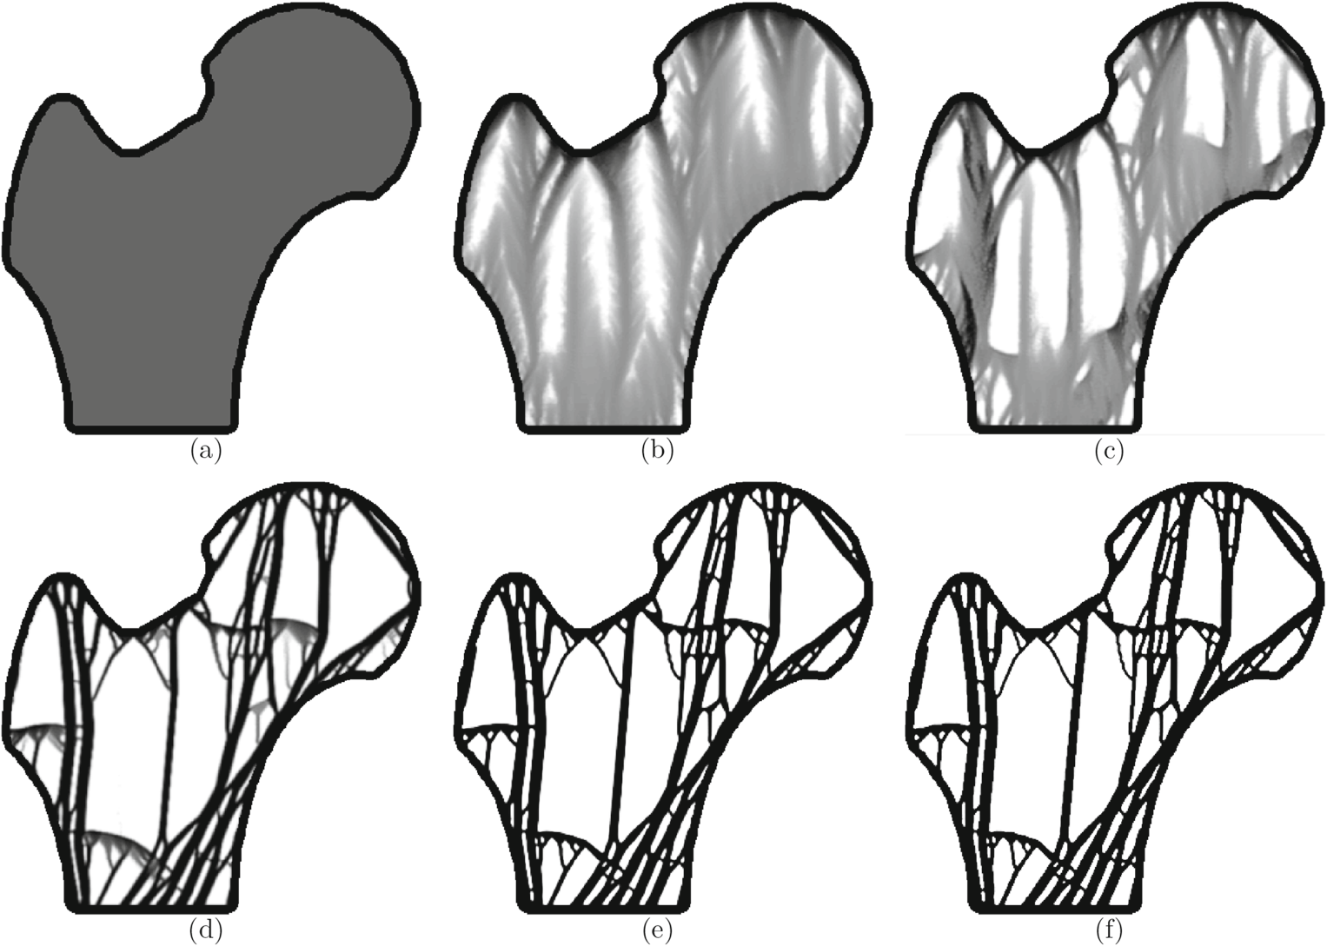
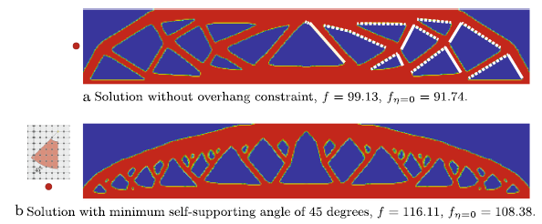
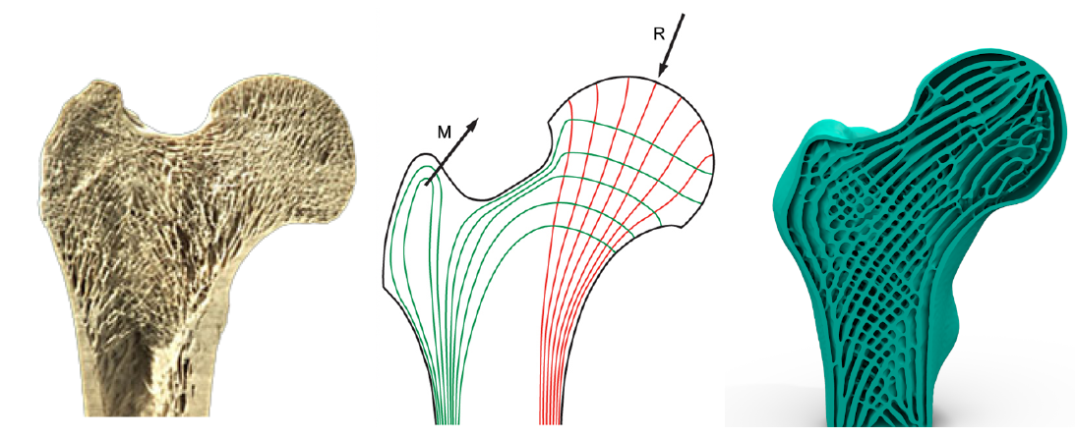
Related Work
Stochastic / Organic Morphology
Explicit Controllability
Support-Free Manufacturability
Gaynor A T, et al. Structural and Multidisciplinary Optimization, 2016
Wu J, et al. TVCG, 2017
Liu Y, et al. Structural and Multidisciplinary Optimization, 2021
Yields regular truss-like structures, lacking natural organic stochasticity.

Slide 11
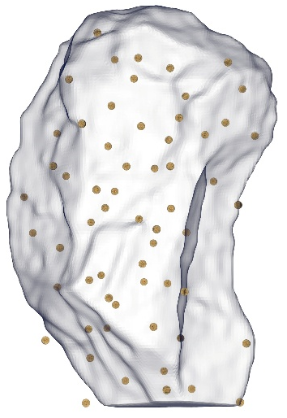
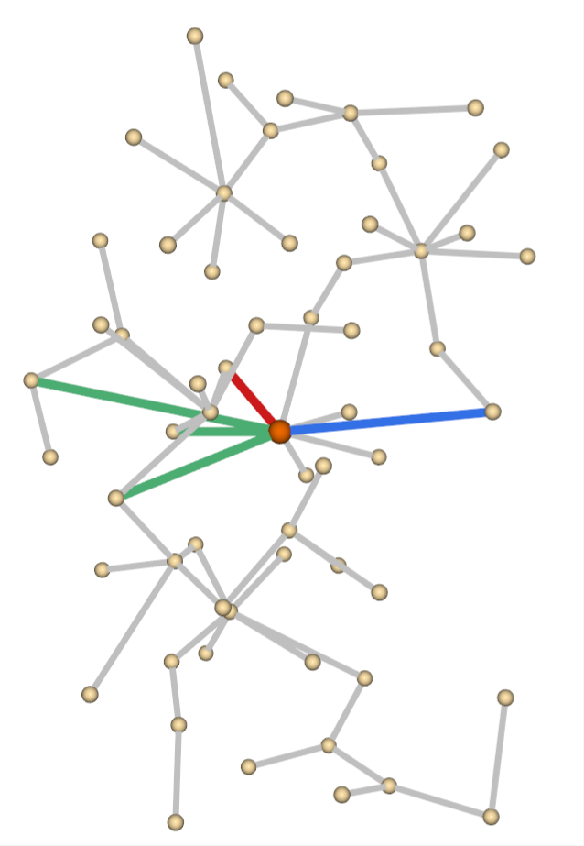
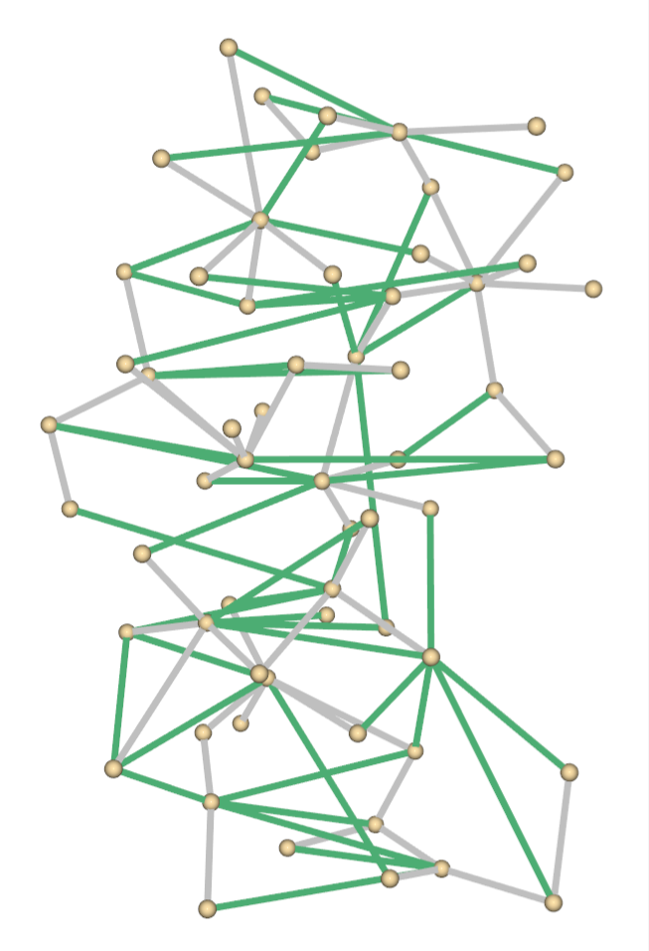
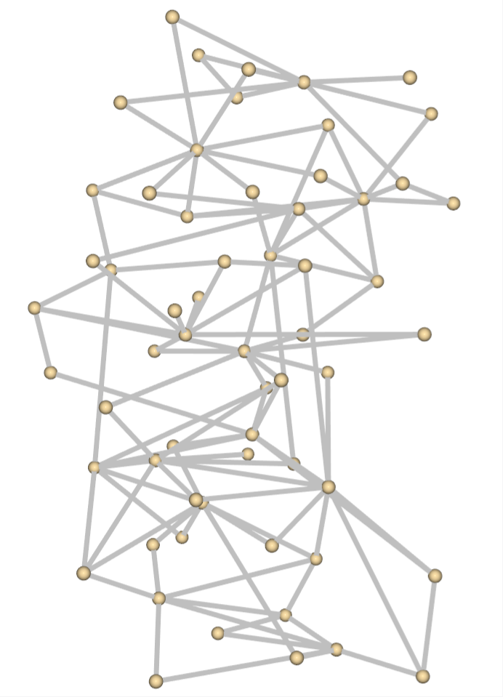
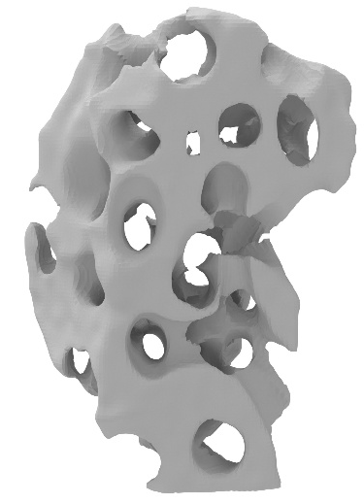
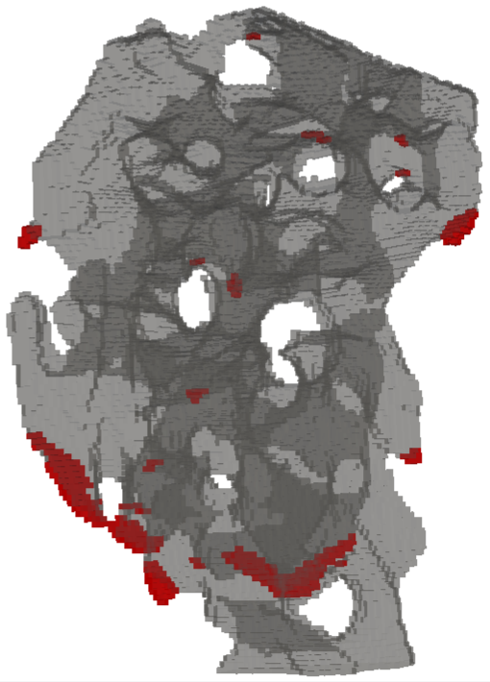
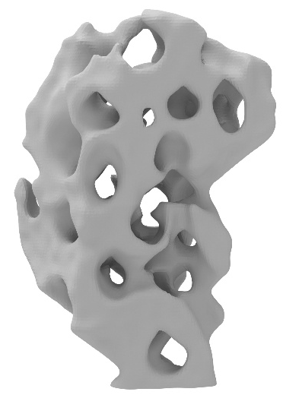
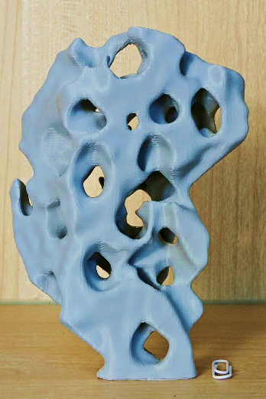
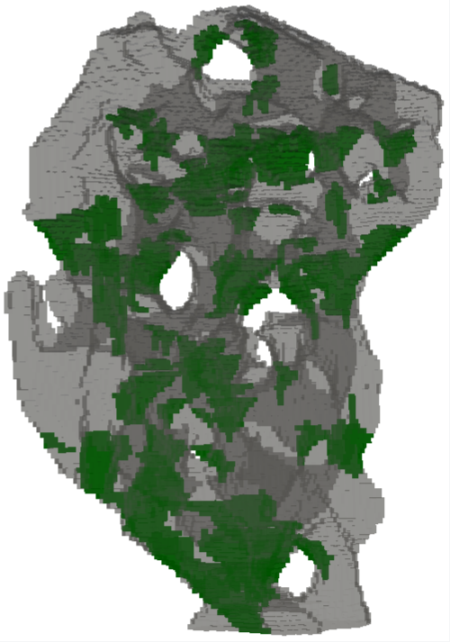
Pipeline: From Perception to Fabrication
Input
Stage 1: VP-Driven Connectivity Optimization
Stage 2: Fabrication-Aware Implicit Pore Modeling
Stage 3: Support-Free Optimization (SFOpt)
Fabricated result

Slide 12
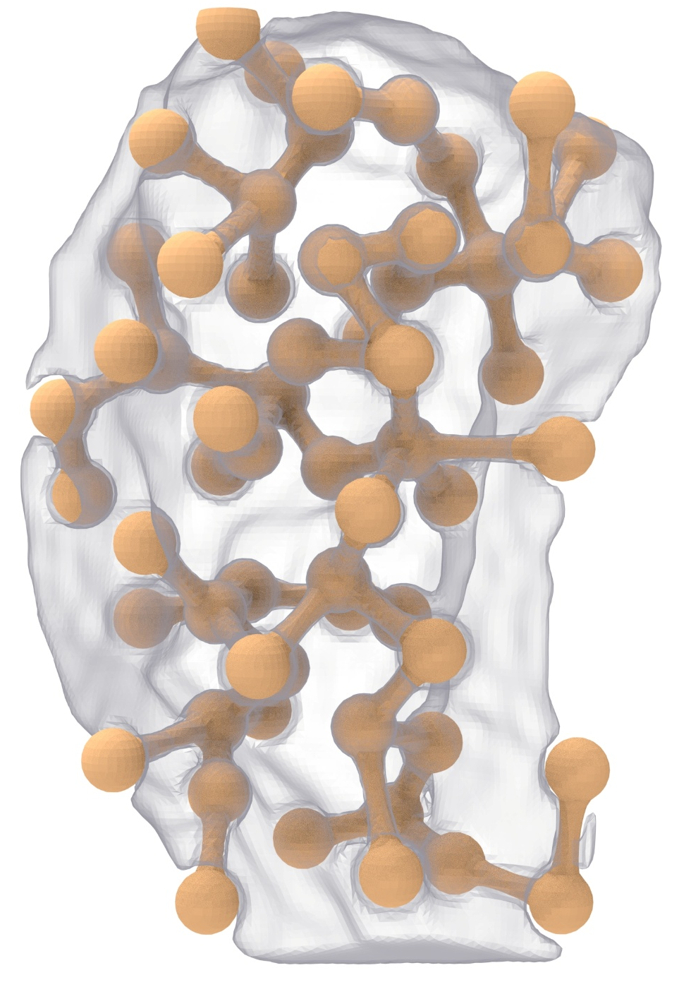
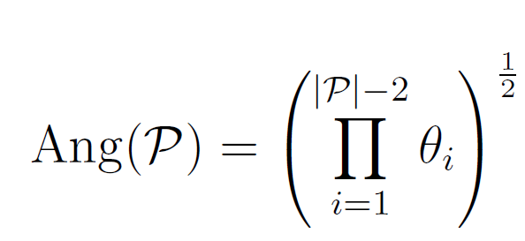



















Stage 1: VP-Driven Connectivity Optimization
VP Metric
$$s_{i}$$
Angle - Straightness of pathways
Evaluates the degree of line-of-sight occlusion at turning corners:
$$s_{i}$$
$$θ_{4}$$
$$θ_{7}$$
$$θ_{6}$$
$$θ_{3}$$
$$k$$
$$s_{m}$$
$$θ_{5}$$
$$s_{n}$$
$$s_{j}$$
$$θ_{2}$$
$$d$$
$$k$$
Square root is used to prevent long paths from decaying too quickly due to accumulated turning penalties.
$$𝔃$$
$$θ_{1}$$
$$𝔃$$
$$s_{j}$$
$$s_{q}$$

Slide 13
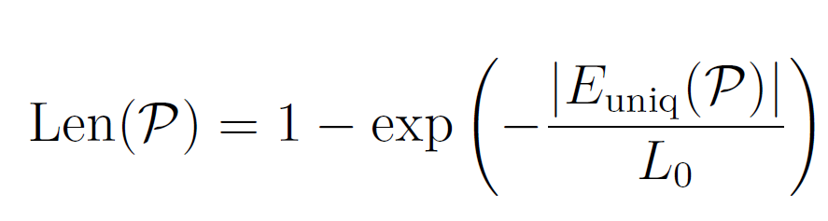

Stage 1: VP-Driven Connectivity Optimization
VP Metric
$$s_{i}$$
2. Length — Depth of penetration
Used to evaluate whether the path has sufficient topological extensibility:
$$s_{i}$$
$$θ_{4}$$
$$θ_{7}$$
$$θ_{6}$$
$$θ_{3}$$
$$k$$
$$s_{m}$$
$$θ_{5}$$
$$s_{n}$$
$$s_{j}$$
$$θ_{2}$$
$$d$$
$$k$$
determined by the number of valid edges contained in the path or the spatial length of the path.
$$𝔃$$
$$θ_{1}$$
$$𝔃$$
$$s_{j}$$
$$s_{q}$$

Slide 14
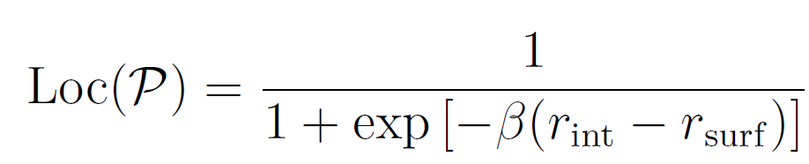

Stage 1: VP-Driven Connectivity Optimization
VP Metric
Surface kernel
$$s_{i}$$
3. Location — Internal traversal preference
Used to distinguish tubes that truly penetrate the interior of the model from tubes located only near the surface:
$$s_{i}$$
$$θ_{4}$$
$$θ_{7}$$
$$θ_{6}$$
$$θ_{3}$$
Internal points
$$k$$
$$s_{m}$$
$$θ_{5}$$
$$s_{n}$$
$$s_{j}$$
$$θ_{2}$$
$$d$$
$$k$$
This item is calculated based on the proportion of points along the path that lie inside the model or on its surface.
$$𝔃$$
$$θ_{1}$$
$$𝔃$$
$$s_{j}$$
$$s_{q}$$

Slide 15
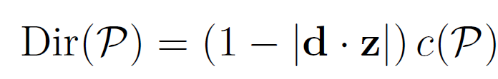
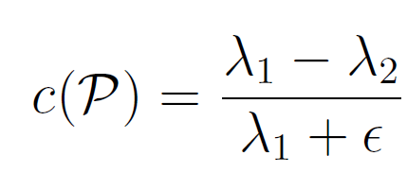
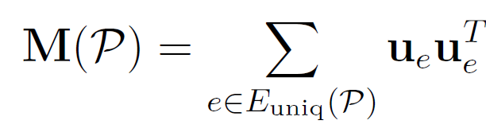

Stage 1: VP-Driven Connectivity Optimization
VP Metric
$$s_{i}$$
4. Direction — Viewing orientation bias
Evaluates whether the primary direction of the path meets the target VP requirement:
$$s_{i}$$
$$θ_{4}$$
$$θ_{7}$$
$$θ_{6}$$
$$θ_{3}$$
$$k$$
$$s_{m}$$
$$θ_{5}$$
$$s_{n}$$
$$s_{j}$$
Here:
and are the largest and second largest eigenvalue of the matrix M(P).
$$θ_{2}$$
$$d$$
$$k$$
$$𝔃$$
$$θ_{1}$$
$$𝔃$$
$$s_{j}$$
$$s_{q}$$
Notes:
Direction item is calculated based on the angle between the primary direction of the path and the vertical reference direction.

Slide 16
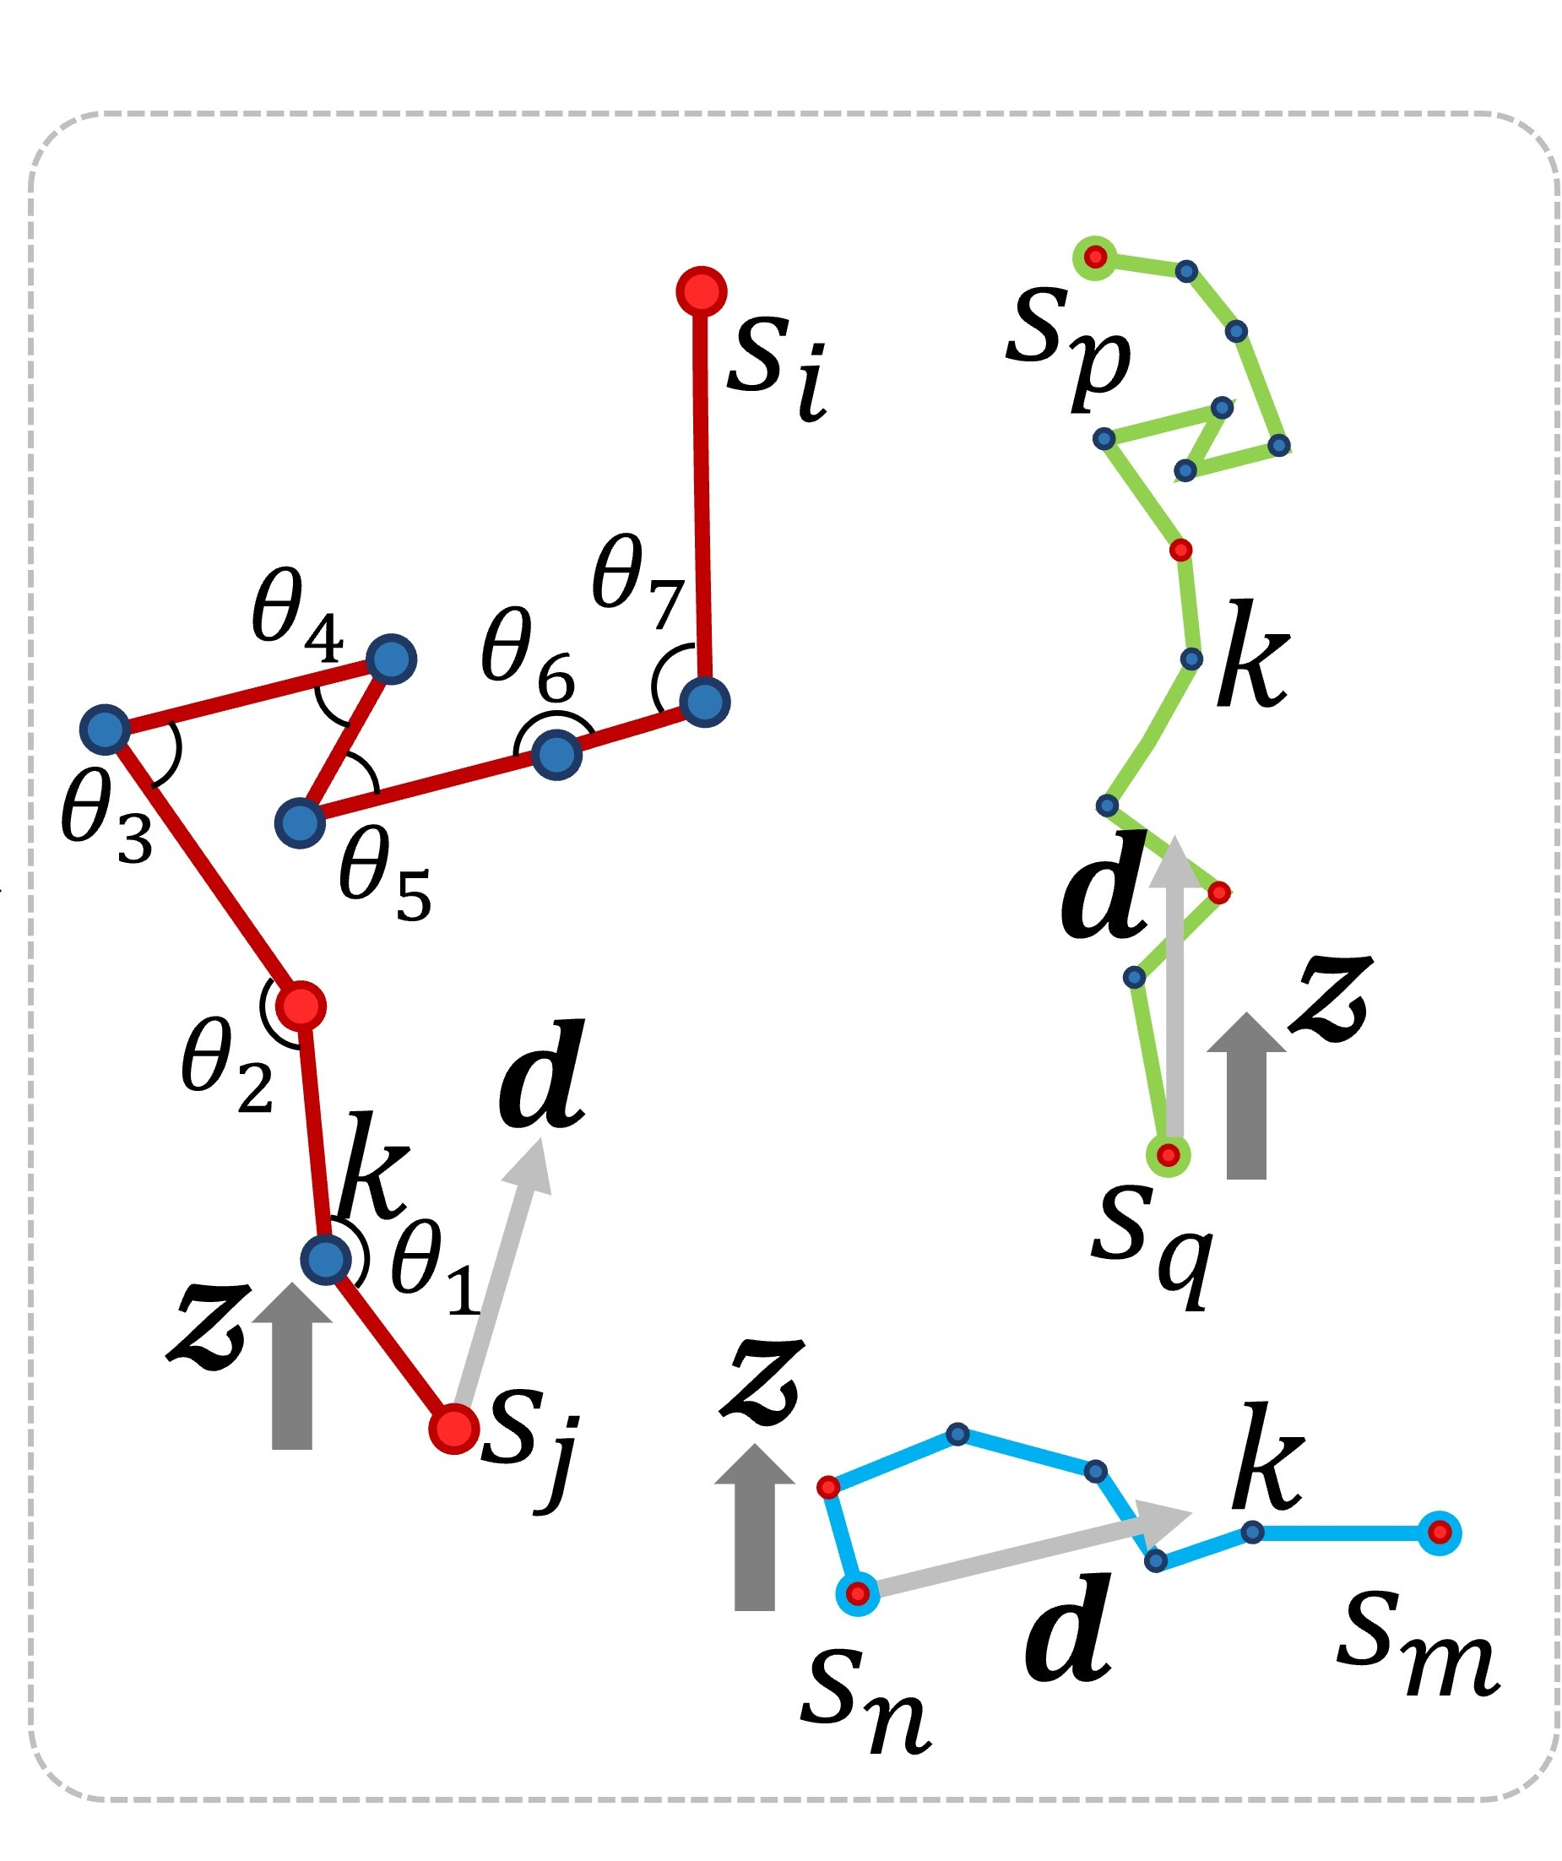
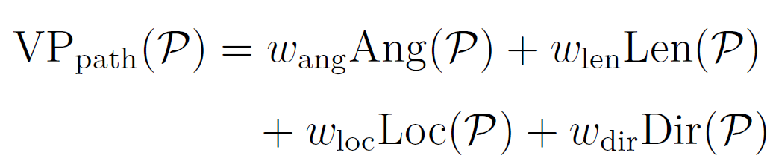
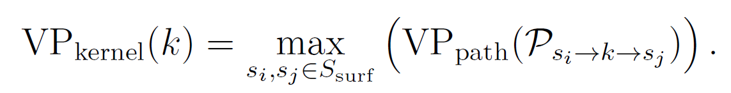
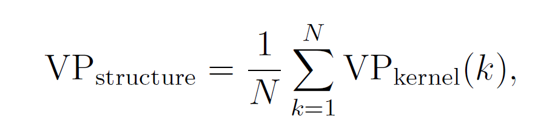

Stage 1: VP-Driven Connectivity Optimization
VP Metric
$$s_{i}$$
Max VP
$$k$$
$$s_{m}$$
$$s_{n}$$
$$s_{j}$$
$$𝔃$$
$$s_{q}$$

Slide 17












Stage 1: VP-Driven Connectivity Optimization
Connectivity Optimization via MBDST+
MBDST+：starts from an MBDST backbone and refines it through VP-driven edge addition and replacement under bounded-degree constraints.
MST (Minimum Spanning Tree):
sparse but visually insufficient.
MSC (Morse-Smale Complex):
rich but dense and redundant.
MBDST (Minimum Bounded-Degree Spanning Tree):
bounded-degree but VP-blind.
MBDST+:
VP-driven, sparse, and fabrication-aware.
$$\left|E\right|=26$$
$$VP=0.639$$
(a) MST
$$\left|E\right|=86$$
$$VP=0.734$$
(b) MSC
$$\left|E\right|=50$$
$$VP=0.721$$
(c) MBDST+

Slide 18


Stage 1: VP-Driven Connectivity Optimization
Connectivity Optimization via MBDST+
Edge Operations: By optimizing connectivity under edge budgets and degree bounds, we maximize visual permeability with minimal material erosion.
Edge Addition: Add edges that yield a positive global VP gain without violating degree bounds.
Edge Replacement: Replace existing edges with better candidates to improve both local and global VP.
Pore Centers (Nodes)
Local Edge Operations
Red edges replaced by Blue; Green edges added

Slide 19
Stage 1: VP-Driven Connectivity Optimization
Connectivity Optimization via MBDST+
Edge Operations: By optimizing connectivity under edge budgets and degree bounds, we maximize visual permeability with minimal material erosion.
Pore Centers (Nodes)
Local Edge Operations
Cumulative edge set after a single iteration
Final optimized topological skeleton

Slide 20




Stage 2: Fabrication-Aware Implicit Pore Modeling
Gaussian Implicit Modeling
Fabrication-Aware Initialization: bias the initial geometry toward the build direction , minimizing overhangs before any optimization begins
Z
Z
$$u_{1}$$
Z
$$u_{1}$$
Z
u
$$u_{2}$$
$$u_{3}$$
X
Y
X
Y
X
Y
X
Y
Isotropic Spherical Kernels
Orthotropic kernels elongated along the Z-axis
Local axes (u) are sampled within a cone
Resulting Stochastic Geometry
Elongation Ratio Sampling: Transverse scale is randomly sampled, and axial scale is elongated by ratio ρ.
Axes Sampling: The major axis is sampled within a 15° cone to break axial symmetry.

Slide 21














Stage 2: Fabrication-Aware Implicit Pore Modeling
Gaussian Implicit Modeling
Collision Handling: Overlaps are detected via SAT (Separating Axis Theorem) and resolved by uniform scaling along the penetration axis.
$$k_{i}$$
$$k_{j}$$
$$k_{i}$$
$$k_{j}$$
$$\left|∆\text{∙ }\text{n}\right|$$
$$\left|∆\text{∙ }\text{n}\right|$$
$$c_{i}$$
$$c_{j}$$
$$c_{i}$$
$$c_{j}$$
n
n
$$h_{i}(\text{n})$$
$$h_{j}(\text{n})$$
$$h_{i}′(\text{n})$$
$$h_{j}′(\text{n})$$

Slide 22



Stage 2: Fabrication-Aware Implicit Pore Modeling
Gaussian Implicit Modeling
Implicit Field Extraction

Slide 23



Stage 3: Support-Free Optimization
Differentiable Layer-wise AM Filter & Support-Free Optimization
Unsupported voxels (red) are pruned
Layer-wise AM filter
Supporting voxels (green) are added
Differentiable SoftMin Operator
Notes:
Differentiable SoftMin Operator Simulates the Dependence of Upper Layers on Lower Layer Support Domains During Layer-by-Layer Deposition
Due to its differentiability, the upper-layer structure lacking support can propagate gradients downward, guiding the optimizer to either grow supporting material from below or trim the overhang.

Slide 24

Stage 3: Support-Free Optimization
Differentiable Layer-wise AM Filter & Support-Free Optimization
Unsupported voxels (red) are pruned
Layer-wise AM filter
Supporting voxels (green) are added
Optimization objective:
Notes:
Differentiable SoftMin Operator Simulates the Dependence of Upper Layers on Lower Layer Support Domains During Layer-by-Layer Deposition
Due to its differentiability, the upper-layer structure lacking support can propagate gradients downward, guiding the optimizer to either grow supporting material from below or trim the overhang.

Slide 25
















Results
Experimental Validation - Validation of the VP Metric
$\left(a\right).\left|E\right|$ $=64, VP=0.7571,\text{Porosity}\text{ = }\text{47.06}\text{\%}$
$$\left(c\right).\left|E\right|=69, VP=0.7839,Porosity= 48.17\%$$
$\left(b\right).\left|E\right|=64, VP=0.8241,Porosity= 49.07\%$
$$\left(d\right).\left|E\right|=69, VP=0.8356,Porosity=50.89\%$$

Slide 26










Results
Experimental Validation - User Study
VP Only
Integrated (VP + Fab)
VP Only
Integrated (VP + Fab)
VP Only
Integrated (VP + Fab)
VP Only
Integrated (VP + Fab)
User Study UI
Representative User Study Rankings

Slide 27
Results
Experimental Validation - User Study
VP Only
Integrated (VP + Fab)
Representative User Study Rankings

Slide 28


Results
Experimental Validation - Visual Comparison of MST, MSC, and MBDST+ Strategies
Model | Strategy | Edges | Porosity | VP | Unsup. Voxels
N=50 | MST | 49 | 41.04% | 0.7177 | 558
 | MSC | 162 | 68.71% | 0.7691 | 1467
 | MBDST+ | 89 | 54.15% | 0.8534 | 1110
 | SFOpt | 89 | 48.47% | 0.8534 | 5
N=60 | MST | 59 | 40.68% | 0.6979 | 1102
 | MSC | 180 | 66.75% | 0.7491 | 619
 | MBDST+ | 112 | 58.24% | 0.8521 | 1008
 | SFOpt | 112 | 51.78% | 0.8521 | 6
N=70 | MST | 69 | 40.36% | 0.6702 | 486
 | MSC | 260 | 70.89% | 0.7839 | 1060
 | MBDST+ | 140 | 61.48% | 0.8572 | 929
 | SFOpt | 140 | 53.74% | 0.8572 | 12
N=80 | MST | 79 | 40.69% | 0.6735 | 749
 | MSC | 200 | 63.59% | 0.7345 | 1518
 | MBDST+ | 150 | 56.67% | 0.8724 | 1732
 | SFOpt | 150 | 50.85% | 0.8724 | 7

Slide 29






















Results
Experimental Validation - Sensitivity Analysis of VP Weights
Max-VP
paths
Tunnels
Overlay
Porous
Result
Max-VP
paths
Tunnels
Overlay
Porous
Result
Max-VP
paths
Tunnels
Overlay
Porous
Result
Case 1 default: KT =(0.5, 0.1, 0.1, 0.3)
Case 3 only $w_{len}$: KT = (0, 1, 0, 0)
Case 5 only $w_{dir}$: KT = (0, 0, 0, 1)
Case 2 only $w_{ang}$: KT = (1, 0, 0, 0)
Case 4 only $w_{loc}$: KT = (0, 0, 1, 0)
Case 6 average:
KT = (0.25, 0.25, 0.25, 0.25)
Visual comparison (part) of porous structures generated under different VP weight configurations
Notes:
原文围绕默认权重wang = 0.5、wlen =0.1、wloc = 0.1、dir = 0.3 进行了敏感性分析。
Different weight configurations drive distinct pathway preferences:
仅强调角度项会产生最直的最大VP 路径；
Emphasizing Length produces longer, more tortuous paths.
Emphasizing Location drives paths deep into the structure's interior.
Emphasizing Direction results in predominantly horizontal sightlines.
Default weights achieve a balanced performance across all aspects.

Slide 30

Results
Experimental Validation - Sensitivity Analysis of VP Weights
Normalized sensitivity of VP statistics under different weight settings;
The grouped bar charts compare structure- and path-level metrics.
Notes:
,showing that each weight term mainly affects its corresponding pathway property, while the default setting provides balanced behavior across multiple metrics.

Slide 31

Results
Experimental Validation - Sensitivity Analysis of VP Weights
A small threshold restricts the search to overly local connections;
A large threshold introduces long-range tunnels and increases structural fragmentation.
Effect of the candidate edge threshold 𝑡𝑝 on graph connectivity and final porous structures.
Notes:
原文围绕默认权重wang = 0.5、wlen =0.1、wloc = 0.1、dir = 0.3 进行了敏感性分析。
Different weight configurations drive distinct pathway preferences:
仅强调角度项会产生最直的最大VP 路径；
Emphasizing Length produces longer, more tortuous paths.
Emphasizing Location drives paths deep into the structure's interior.
Emphasizing Direction results in predominantly horizontal sightlines.
Default weights achieve a balanced performance across all aspects.

Slide 32





Results
Experimental Validation - Geometric Quality & Physical Fabrication

Slide 33

Conclusion
Contributions:
Computable Aesthetic Metric: Formulate VP as a graph-based, optimizable measure of pathway organization.
Topology-Driven VP Optimization: Propose MBDST+ to improve VP under sparse, bounded-degree connectivity.
Support-Free Organic Generation: Integrate support-free manufacturability throughout the pipeline, converting optimized graphs into printable stochastic geometry.
Limitations:
Fixed kernel sampling bounds the achievable VP.
Current VP ignores aperture and cross-sectional area.
Build-direction-biased kernels limit morphological diversity.
FDM thermomechanical artifacts are not fully modeled.
Dense voxel optimization limits scalability.
Future work:
Joint Kernel-Connectivity Optimization.
Geometry-Aware VP Metric.
Physics-Aware Fabrication Modeling.

Slide 34
Thank you for your attention!
Models & Codes online: https://github.com/LLLiuxk/TaihuStone

Slide 35
Thank you for your attention!
Models & Codes online: https://github.com/LLLiuxk/TaihuStone

